Slide 1
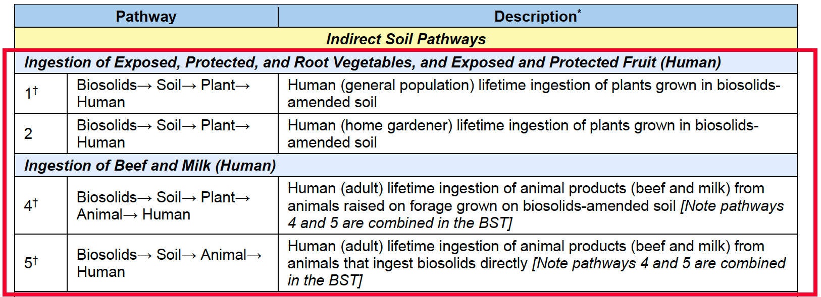
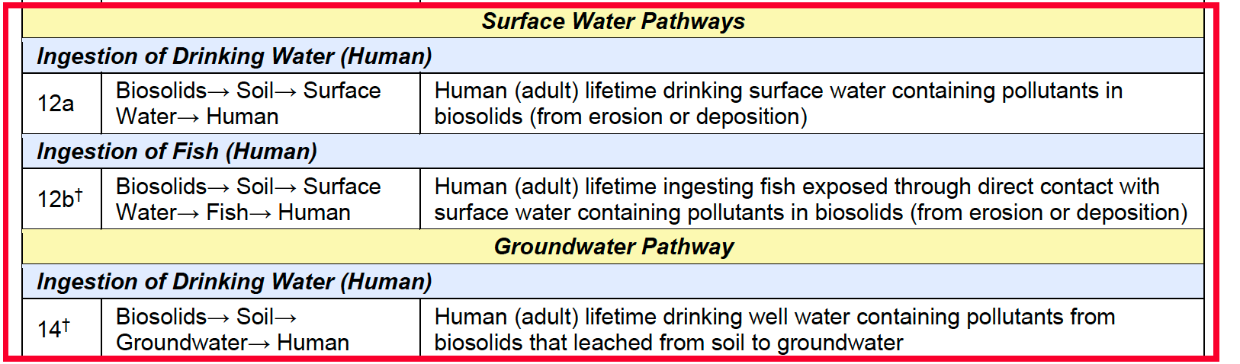
Biosolids Screening Tool (EPA)

Slide 2
Biosolids Screening Tool (EPA)
Plant
Land Application Unit;
Generic Soil Column Module
Soil
Animal
Biosolids
Human
Watershed and Waterbody Modeling
Surface
Water
Fish
Ground
Water

Slide 3
Biosolids Locations
Biosolids-amended agricultural areas
Biosolids-amended soil
Biosolids-amended agricultural field
Biosolids
Application
Municipal biosolids
Municipal biosolids- applied soil
Wastewater treatment plant sludge applied soil
Compost amended soil
Industrially impacted Biosolids-amended soil

Slide 4
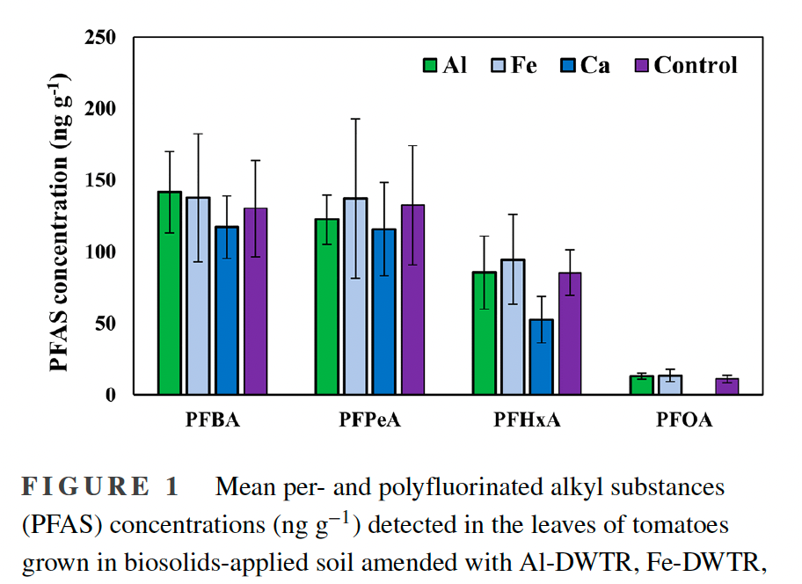
Effects of drinking water treatment residual amendments to biosolids on plant uptake of per- and polyfluoroalkyl substances

Slide 5
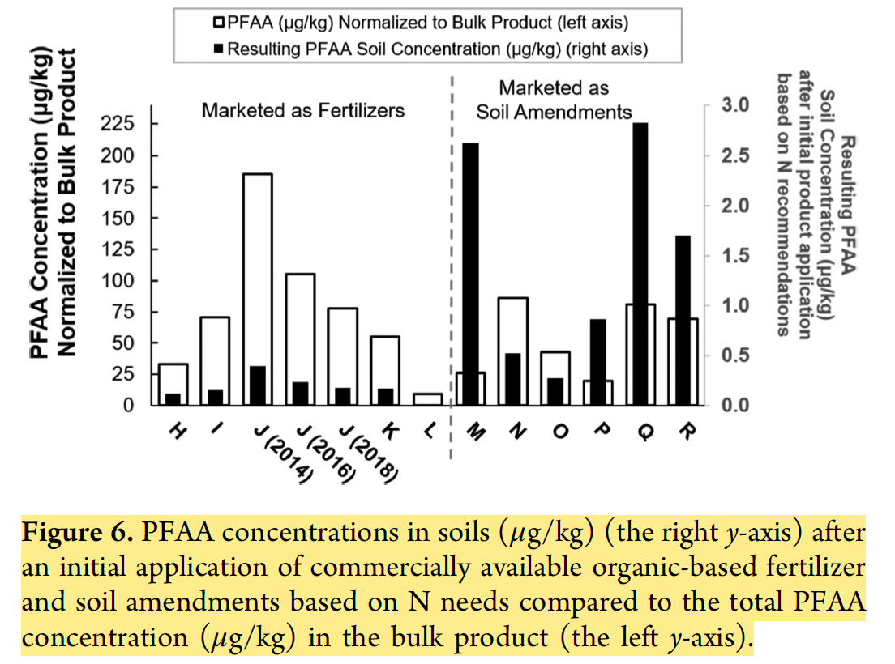
Characterizing and Comparing Per- and Polyfluoroalkyl Substances in Commercially Available Biosolid and Organic Non-Biosolid-Based Products

Slide 6
Characterizing and Comparing Per- and Polyfluoroalkyl Substances in Commercially Available Biosolid and Organic Non-Biosolid-Based Products

Slide 7
Literature Search
Title | Type | Content
Distribution, behaviour, bioavailability and remediation of poly- and per-fluoroalkyl substances (PFAS) in solid biowastes and biowaste-treated soil | Review | Behaviour and bioavailability of PFAS in biowastes and biowaste-treated soil
Occurrence and Fate of Perfluorochemicals in Soil Following the Land Application of Municipal Biosolids
Concentrations, Distribution, and Persistence of Perfluoroalkylates in Sludge-Applied Soils near Decatur, Alabama, USA
Perfluorooctanoic acid (PFOA) and perfluorooctanesulfonic acid (PFOS) concentrations in the South Korean agricultural environment: A national survey

